Slide 1
IBM Cloud Private An Introduction

Slide 2
IBM Cloud Private
Develop with speed, the flexibility to integrate across all clouds, and the control and security of your existing data center solutions
Fast, Flexible, and Secure
Industry leading open source container orchestration platform across private, dedicated, and public clouds
Open
by Design
Optimize current investments with cloud-enabled middleware, databases and analytics services from IBM
Enterprise
Ready
Analytics and cognitive capabilities to gain insights into your data
Intelligent Insights
For IBM Internal Use Only

Slide 3
IBM Cloud Private
Patterns
Templates
Code +
Packaging as Container Image
Code +
Manifest
Event/Action
API
Event
Handlers
Cloud
Foundry
Custom
Scheduling
Kubernetes
Automation &
Orchestration
(Chef, Terraform etc.)
Service
(SaaS)
Containers
Containers
Containers
Docker
Garden -> Docker
Docker
Infrastructure
(on and off premises) (Intel, Power, z)

Slide 4
An integrated solution leveraging widely adopted open-source projects
A Kubernetes core with PaaS, Serverless and multi-cloud functions optionally activated
Multi-Cloud Automation
Terraform
Serverless OpenWhisk (*)
PaaS
Cloud Foundry
CaaS
Kubernetes
Operating System (VMWare / OpenStack / PowerVM / zLinux)
(*) – Serverless support planned for 2018

Slide 5

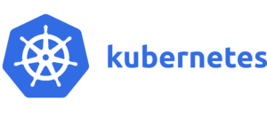


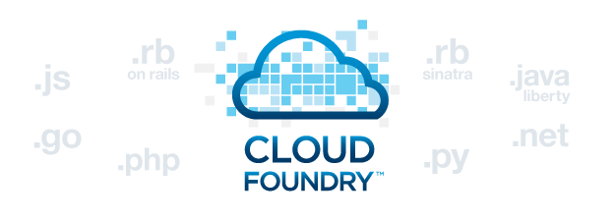

IBM Cloud Private
IBM Cloud private -Kubernetes based container platform
Industry leading container orchestration platform across private, dedicated & public clouds
Common Services
To simplify hybrid automation, integration, management
Application Performance Management
For legacy apps, 12-factor apps, and hybrid workload
Transformation Advisor
To transform legacy apps
IBM Middleware, Data & Analytics Services
Cloud enabled middleware, databases & analytics to leverage and optimize current investments
Cloud Automation Manager
Manage multi & hybrid cloud workloads, Automate VM based application deployment, enable self-service composition and delivery and maintain cloud infrastructure-as-code.
Cloud Foundry
For rapid application development & deployment of cloud native applications and extend your applications with cognitive capabilities

Slide 6


Experience from clients drove IBM Cloud private design
Lessons Learnt:
Time to Value Matters: Clients want to Operate an Orchestrated Container Cloud, NOT Assemble One
Fast Time to Value
IBM Cloud private
+
IBM Value-add for Enterprises

Slide 7
IBM Cloud Private capabilities
IBM DevOps Tools + Open Source
IBM Supported Languages & Frameworks
IBM Cloud Private Catalog
IBM API Connect
Management
Optimized runtimes for workloads
Reuse
Common Services

Slide 8
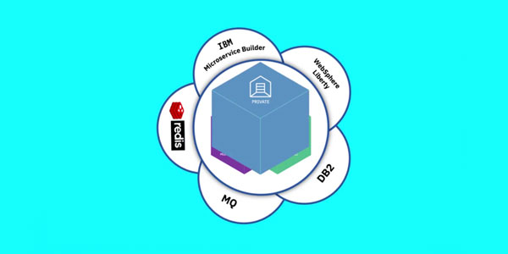
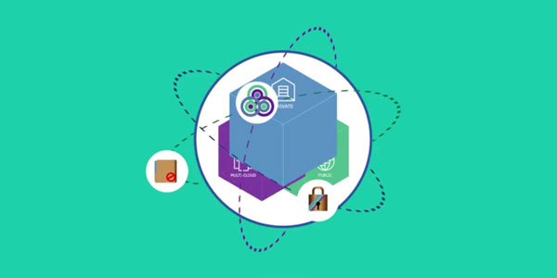
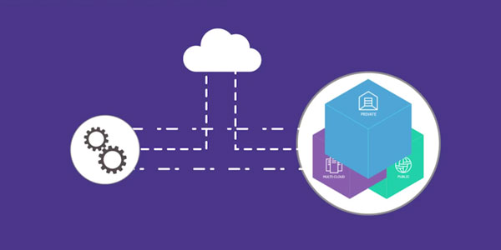



Cloud Native
Cloud Enabled
Hybrid Cloud
Create new cloud-native apps
Streamline development with built-in micro-services, runtimes, containers and Kubernetes orchestration plus integrated management.
Modernize your heritage apps on cloud
Move your apps as-is to the cloud or re-factor an app and use it in new development and application workload models.
Open your data center to work with cloud services
Protect and leverage your in-house data and pull in external sources to fuel your apps.
Notes:
OK, we’ve spoken to what it is, but what will our clients do with it.
There are three workload themes that we should all be familiar with. They are as follows:
Cloud Innovation
Cloud Migration
And Cloud Native
Each has some key things to look out for in your client discussions, along with whom to connect with in IT or the business.

Slide 9
Cloud Native
Cloud Enabled
Hybrid Cloud
Create new cloud-native apps
Streamline development with built-in micro-services, runtimes, containers and Kubernetes orchestration plus integrated management.
Modernize your heritage apps on cloud
Move your apps as-is to the cloud or re-factor an app and use it in new development and application workload models.
Open your data center to work with cloud services
Protect and leverage your in-house data and pull in external sources to fuel your apps.
Notes:
OK, we’ve spoken to what it is, but what will our clients do with it.
There are three workload themes that we should all be familiar with. They are as follows:
Cloud Innovation
Cloud Migration
And Cloud Native
Each has some key things to look out for in your client discussions, along with whom to connect with in IT or the business.

Slide 10
The microservices revolution
A microservices architecture is gaining traction for developing and delivering cloud-native workloads across public, private, and hybrid application environments
Why?
Decomposed into small pieces
Loosely coupled
Easier to scale development
Improved fault isolation
Each service can be developed and deployed independently
Eliminates any long-term commitment to a technology stack
60% of new apps will use cloud-enabled continuous delivery and cloud-native application architectures to enable faster innovation and business agility**
60%
IDC FutureScape: Worldwide Cloud 2016 Predictions – Master the Raw Material of Digital Transformation, November 2015

Slide 11





Microservice Builder
A turn-key approach that is a simple, step-by-step support
End-to-end guidance to ensure a smooth microservices
lifecycle from development to production
Enables developers to compose both hybrid and
cloud-native applications in a microservices framework
Notes:
A turn-key approach that is a simple, step-by-step support detailing how to create cloud-native applications in a microservices framework
End-to-end guidance including configuration, development, deployment, and monitoring, to ensure a smooth microservices lifecycle from development to production
Enables developers to compose both hybrid and cloud-native applications by blending on-premises and cloud services

Slide 12
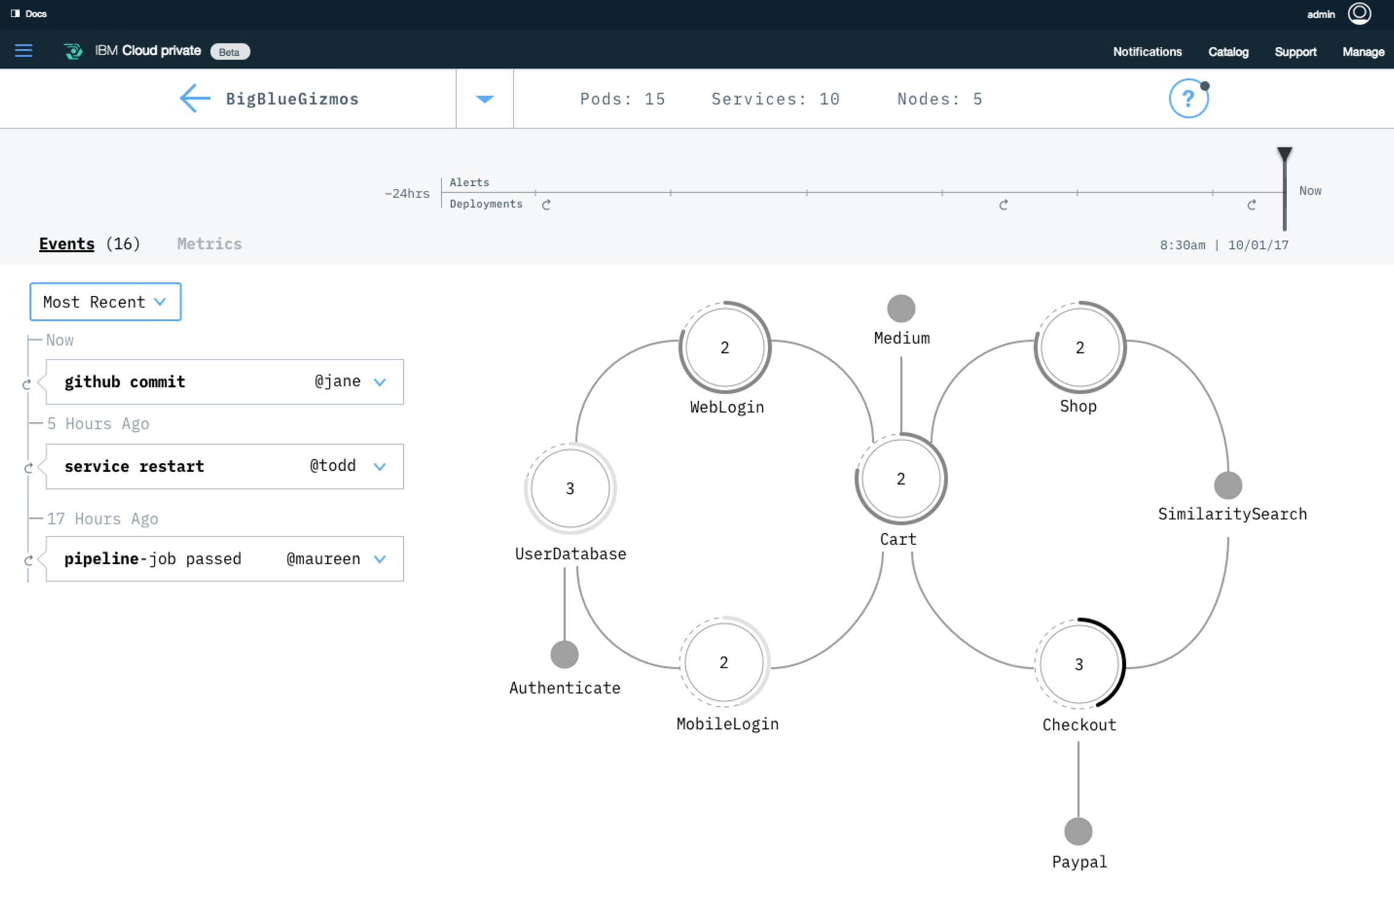
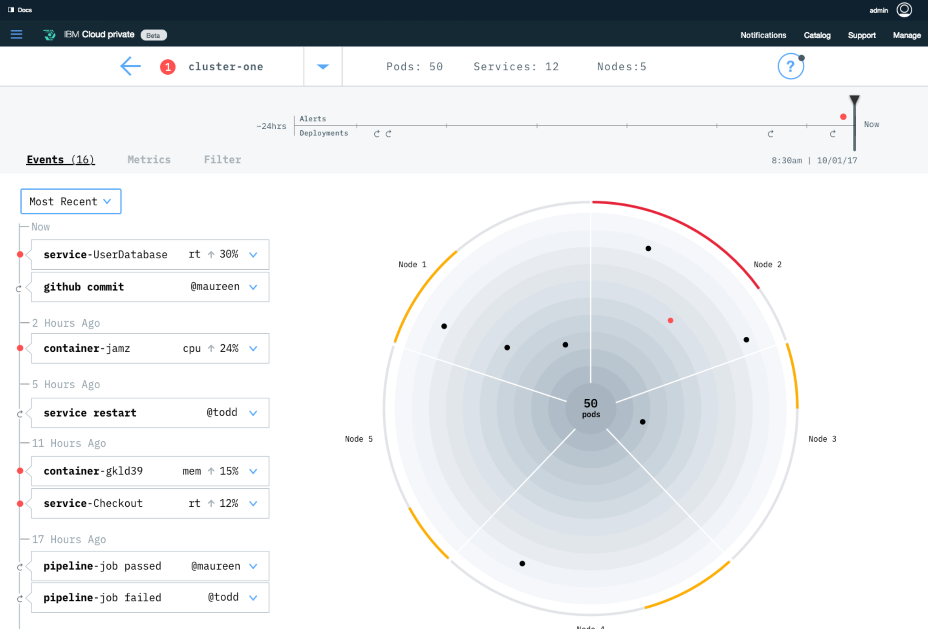
APM for microservices

Slide 13
IBM Cloud Private for cloud-native applications
Challenge: Developers need access to a platform of capabilities to create cloud native applications that meet the security and regulatory requirements of their organization.
IBM’s Cloud Capabilities:
Microservice Builder
APM for microservices
Enterprise grade application development services integrated with the platform runtimes, data and analytics, messaging, DevOps services, etc.

Slide 14
Cloud Native
Cloud Enabled
Hybrid Cloud
Create new cloud-native apps
Streamline development with built-in micro-services, runtimes, containers and Kubernetes orchestration plus integrated management.
Modernize your heritage apps on cloud
Move your apps as-is to the cloud or re-factor an app and use it in new development and application workload models.
Open your data center to work with cloud services
Protect and leverage your in-house data and pull in external sources to fuel your apps.
Notes:
OK, we’ve spoken to what it is, but what will our clients do with it.
There are three workload themes that we should all be familiar with. They are as follows:
Cloud Innovation
Cloud Migration
And Cloud Native
Each has some key things to look out for in your client discussions, along with whom to connect with in IT or the business.

Slide 15



Enterprise applications transformation journey
1
OPTIMIZE
2
MOVE TO CLOUD
3
CONTAINERIZE
4
REFACTOR
Reduce cost and improve performance by selecting the right license and deployment model for existing workloads
Move workloads to the cloud to benefit from Cloud economics, scale, deployment automation, and improved development agility.
Developers are dramatically improving agility using containers to continuously deliver, leveraging extreme standardisation and automation.
Applications are being refactored to cloud native architectures to encompass APIs, micro-services and cognitive capability for innovation and disruption.
Enterprise
application
Enterprise
application
Enterprise
application
Enterprise
application
Enterprise
application
EJB
Servlet
µService
µService
On-Premises
Cloud Affinity
XaaS

Slide 16
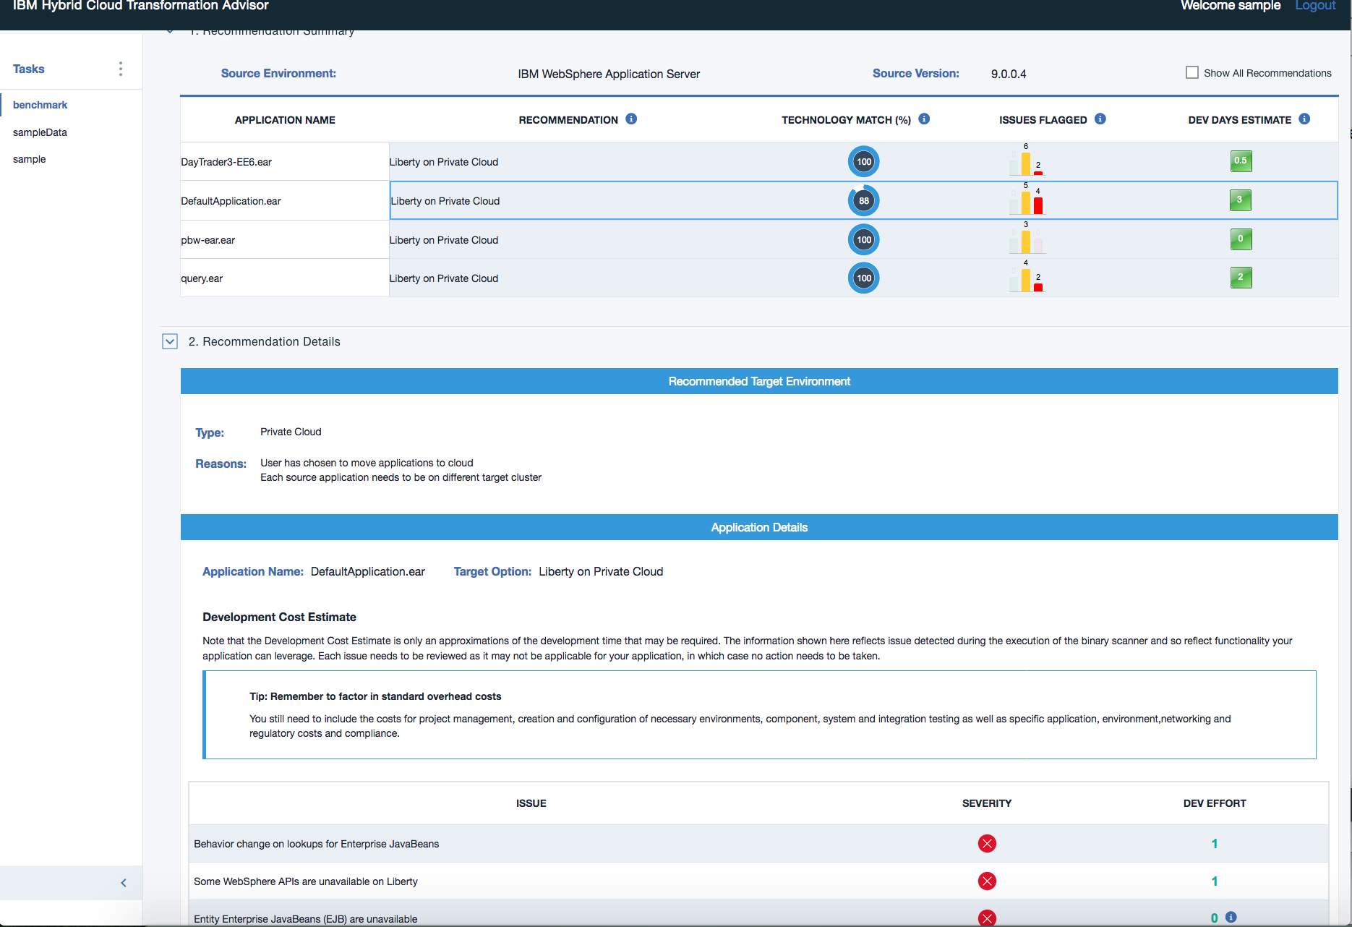
Transformation Advisor

Slide 17
IBM Cloud Private to cloud-enable applications
Use Case: Developers need to cloud enable applications that meet security and regulatory needs. IBM Cloud private provides the platform for rapidly developing and deploying cloud enabled applications, while meeting the security and regulatory needs of the enterprise.
IBM’s Cloud capabilities
Transformation Advisor provides guidance on where to run your critical workloads
Next generation versions of industry leading IBM Middleware and Analytics (WAS, MQ, DB2) to speed innovation and gain new insights into data
Vulnerability assessment
Elastic runtimes enable the enterprise to scale up and scale down as needed

Slide 18
Cloud Native
Cloud Enabled
Hybrid Cloud
Create new cloud-native apps
Streamline development with built-in micro-services, runtimes, containers and Kubernetes orchestration plus integrated management.
Modernize your heritage apps on cloud
Move your apps as-is to the cloud or re-factor an app and use it in new development and application workload models.
Open your data center to work with cloud services
Protect and leverage your in-house data and pull in external sources to fuel your apps.
Notes:
OK, we’ve spoken to what it is, but what will our clients do with it.
There are three workload themes that we should all be familiar with. They are as follows:
Cloud Innovation
Cloud Migration
And Cloud Native
Each has some key things to look out for in your client discussions, along with whom to connect with in IT or the business.

Slide 19




New applications need an agile cloud architecture
Front-end
Back-end
Micro Apps
Transactions
Records
Micro Apps
Native Apps
Public
Off-Premise
EAI (WS)
Processes
Master Data
Applications
Transaction Data
Private
On-Premise
Private
On-Premise
Public
Coding Artifacts
Data Artifacts
Micro Services
Containers
Life Cycle
Management
Traditional Apps
Very fast life cycle
Speed of deploy and execution
Scale for the unpredictable
More stable and predictable life cycle
WS exposure for up stream levels
No Elastic behavior
Notes:
Extending the traditional apps with new born on the cloud applications to have new ways to interact with clients and citizens.
Typically we started buidling the new “mobile” apps with more tranditional intagration through Web Services.
I want to connect my new mobile application with customer data that resides behind my firewall so I access key information on the go – how can I integrate application and data in different locations?
Rapidly develop new applications such as mobile apps in an off-premises cloud environment connecting them to the in-house production via classical ESB (web services)
Typically we see micro-services and container services to deploy the new applications, all with an integrated tool-chain
Integration: Making the right choices for your data and services
fast activation of apps that expose data (as-is)
Secure data access through ESB and application firewalls
Impact :
if data needs to change or new processes/transactions are needed you still be as slow as before (even slower as new unknown aspects are popping up)
No scaling or throttling for the back-end could lead to overloading the traditional application components leading to business interruption

Slide 20
New applications need an agile cloud architecture
Front-end
BL-Tier
Back-end
Micro Apps
Enabled Apps
Transactions
Records
Micro Apps
Native Apps
Public
Off-Premise
Processes
Master Data
Hybrid Integration
Transaction Data
Applications
Private
On/Off-Premise
Private
On-Premise
Public
Coding Artifacts
Data Artifacts
Micro Services
Containers
Blueprints
Life Cycle Management
Traditional Apps
Very fast life cycle
Speed of deploy and execution
Scale for the unpredictable
Fast and automate life cycle
Fast repeatable deploys
Elastic behavior
More stable and predictable life cycle
API/WS exposure for up stream levels
Elastic throttling
Notes:
Extending the traditional apps with new born on the cloud applications to have new ways to interact with clients and citizens.
Now we are cloud enabling existing applications to make sure we can deploy faster new add-ons to the existing applications
The Hybrid integration will allow that new born on the cloud apps can consume and provide data to the new cloud enabled applications to enrich the data
Hybrid Integration: Making the right choices for your data and services
fast activation of apps that expose data from traditional back-ends as well as the new
Secure data access through the API management layer
Throttle the activities to prevent overload or to assure golden clients are getting better service
Impact :
faster deployment of the end to end activation of a business application
New automations needed for the cloud enabled
Application deployment and tool chain to expand into all parts of the multi cloud environment

Slide 21
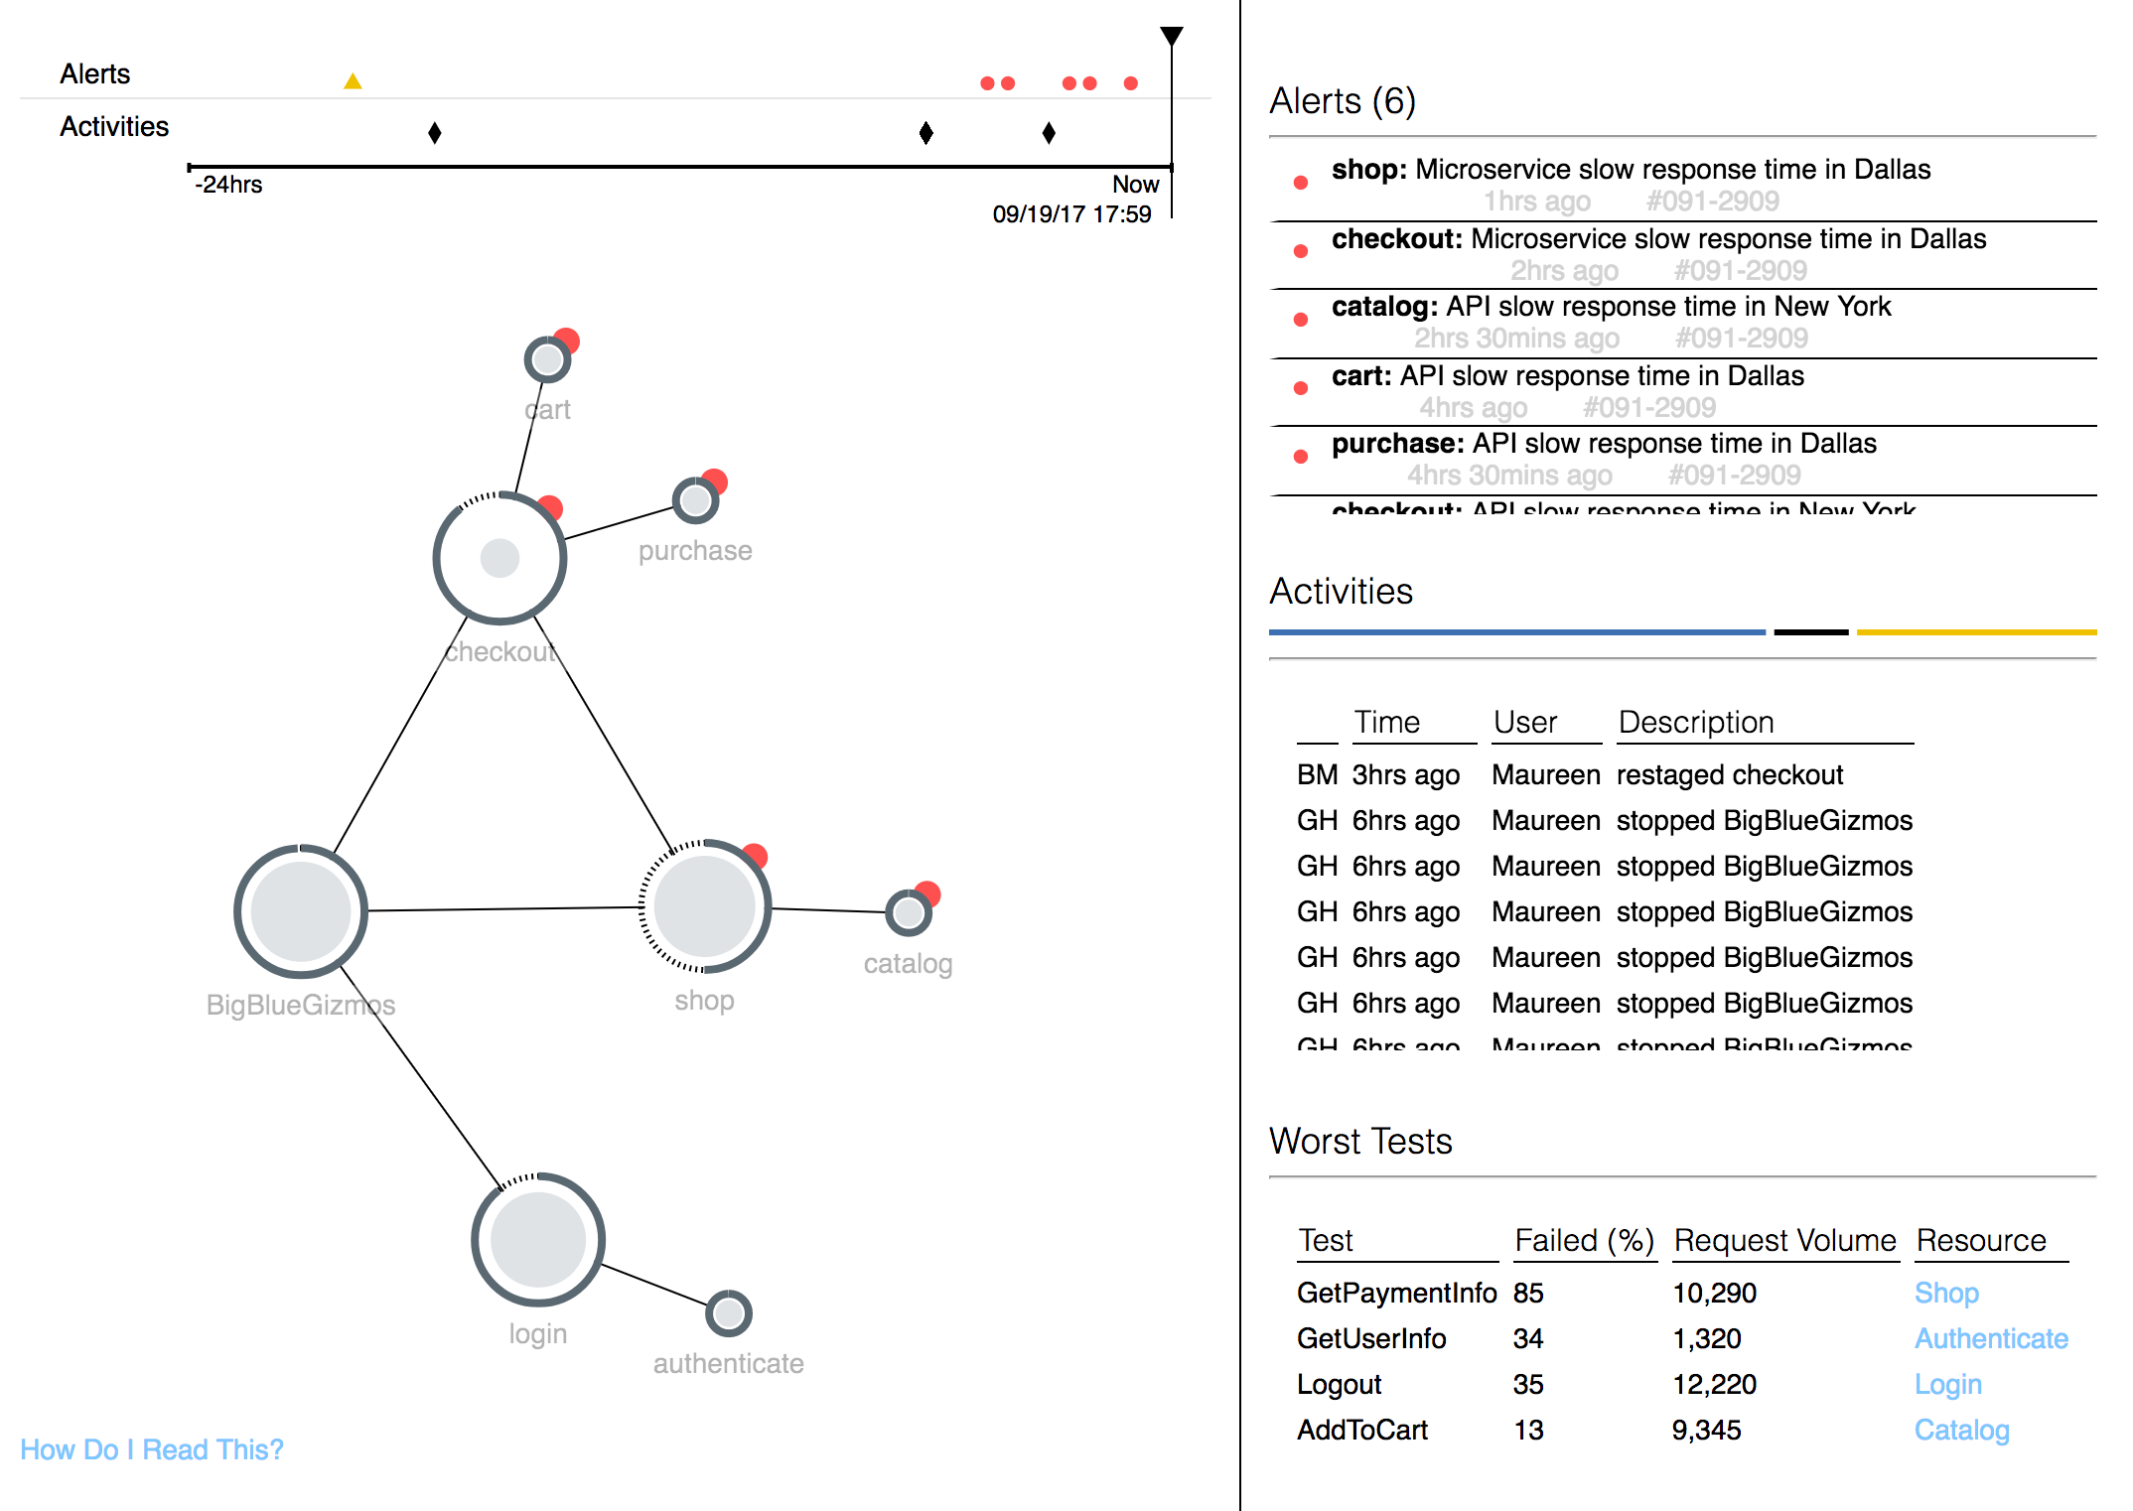
APM for hybrid applications

Slide 22
IBM Cloud private embeds CAM features
Cloud Automation Manager
Multi-cloud deployments using Terraform
Supports IBM Cloud, AWS, Azure, Bare metal, et al.
IBM Middleware, Integration Data, Analytics offerings
Open source catalogue
Blockchain workloads (Hyper ledger)
IBM Cloud Automation Manager
Consistent UX &
REST API
for LOB and developers
Service Composition & Self Service Catalog
Marketplace of pre-built Content
Multi-cloud workload Provisioning
Workflow automation
Accelerate delivery of new capabilities
Hybrid cloud without complexity
Notes:
IBM Cloud private – What changed recently?
IBM Cloud private continues to grow in importance to IBM and our clients
Next-generation private cloud, helps to transform enterprise workloads with cloud native services and analytical insights
To further enhance the IBM Cloud private (ICp), Automation Content, and Cross-GTM objectives, Cloud Automation Manager (CAM) will be merged with ICp into a single offering.
We will enhance IBM Cloud private by adding the following capabilities from Cloud Automation Manager:
Automate deployment of VM and mixed VM / container based workloads leveraging open source Terraform and Chef
Compose and publish workflow orchestration services
Provision and manage workloads in multiple clouds (public/private, non-IBM, etc)
Marketplace experience and collection of curated content built with best practices for container /cloud-native and VM / cloud-enabled IBM Middleware, Data and Analytics products
These CAM capabilities will be delivered in ICp as the Automation and Orchestration Service (AOS).

Slide 23
IBM Cloud Private for hybrid cloud applications
Use Case: Enterprises need to integrate data and application services (from other locations) in their new cloud native and cloud enabled applications which are running in their own data center.
IBM’s Cloud capabilities
Kubernetes-based orchestration platform
API Management, Application Integration Suite
Cloud foundry platform for service syndication
Multi-cloud deployments through CAM
APM for Hybrid Workload

Slide 24


IBM Cloud private transforms the way IT operations and developers work
Todd
Operations / Admin
Responsible for infrastructure, security, and management of the environment.
Jane
Enterprise Developer
Responsible for modernizing existing applications and creating new Cloud Native Workloads.
IBM Cloud private empowers both developers and administrators to meet business demands:
IT Operations and Administrators can quickly set up a modern, flexible, and compliant private cloud on enterprise infrastructure that enables enterprise developers to innovate; they can also integrate with their existing management tools and processes
Developers can create new cloud-native applications, optimize existing ones, and securely connect their applications with data and services across all clouds

Slide 25



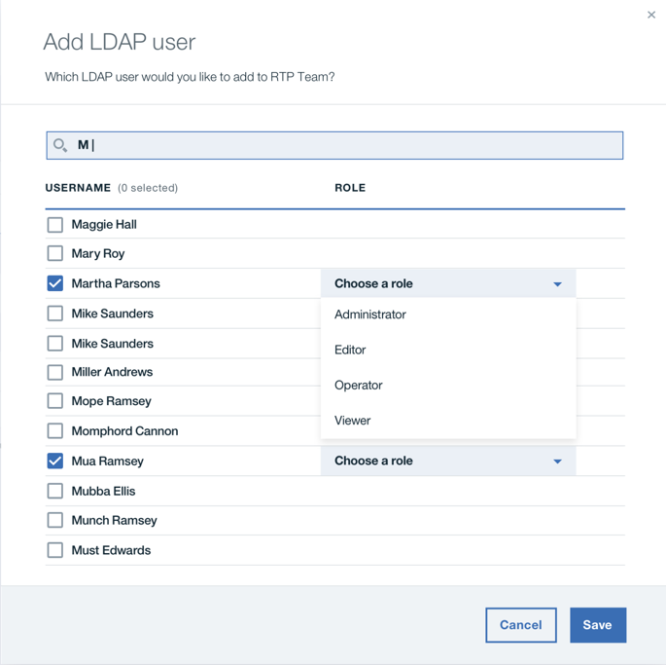
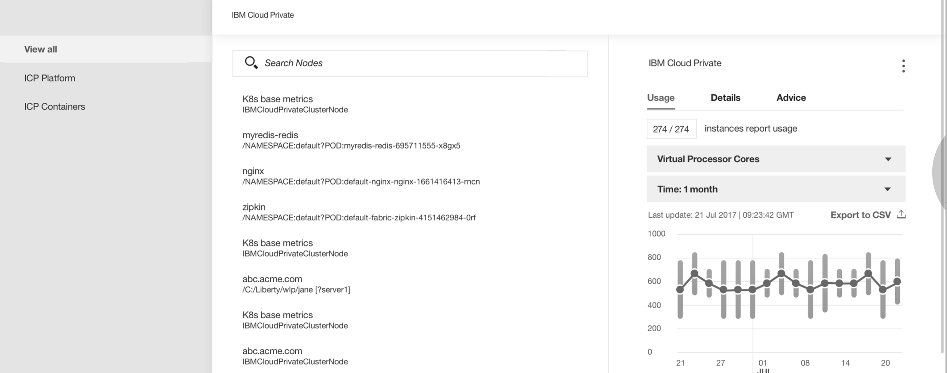
Advanced platform features for production
Network segmentation with SDN
Vulnerability Advisor : analysis of containers security (vulnerabilities and compliance with good practices)
Image
Registry
Vulnerability Advisor
IMG
IMG
IMG
IMG
IMG
Advanced role based access control
Auditability and monitoring with ELK (*) and Prometheus
* - ELK (ElasticSearch / Logstash / Kibana) : log management and analysis

Slide 26
Why IBM?
Workload-centric strategy for private cloud, with support for Infrastructure Automation, Containers with Kubernetes and Cloud Foundry delivery models for IBM middleware, Third Party middleware, and user applications, infused with Cognitive services.
Deliver operational capabilities in private cloud derived from our experience operating these platforms at scale.
Broad spectrum of locality models, including private, dedicated
Customer-held keys to enable encrypted data transmission between each - private, dedicated, and public
Methodologies & tools for progressive transformation of the enterprise.

Slide 27
IBM Cloud private

Slide 28

Thank you

